Slide 1
14.5 Gradient Boosting

Slide 2
The most popular way to build deep regression and classification trees via addition is by summing together shallower ones, growing the tree sequentially one shallow member at a time.
This is an instance of the general boosting method introduced in Chapter 11, often referred to as gradient boosting.

Slide 3
At the m’th round of boosting we begin with a model consisting of a fully tuned linear combination of m−1 units of a universal approximator
Each function in this sum is a tree-based unit (e.g., a stump) whose split point(s) and leaf values have been chosen optimally.

Slide 4
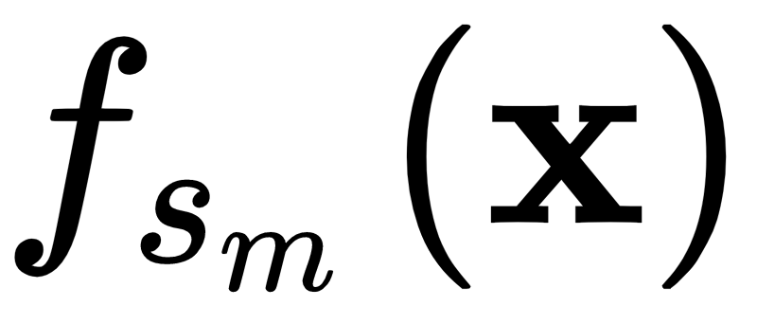
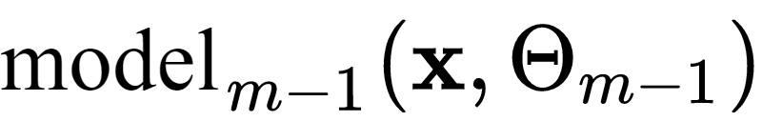
The m’th round of boosting involves a search over a range of suitable candidates and a corresponding optimization of each candidate's leaf values.
To construct the next candidate model we add a prospective unit to , forming
We then optimize the leaf values of using an appropriate cost function (e.g., the Least Squares cost for regression and Softmax cost for classification).

Slide 5
Boosting with regression stumps is often interpreted as successive rounds of 'fitting to the residual' of a regression dataset (as illustrated below).

Slide 6
